Slide 1
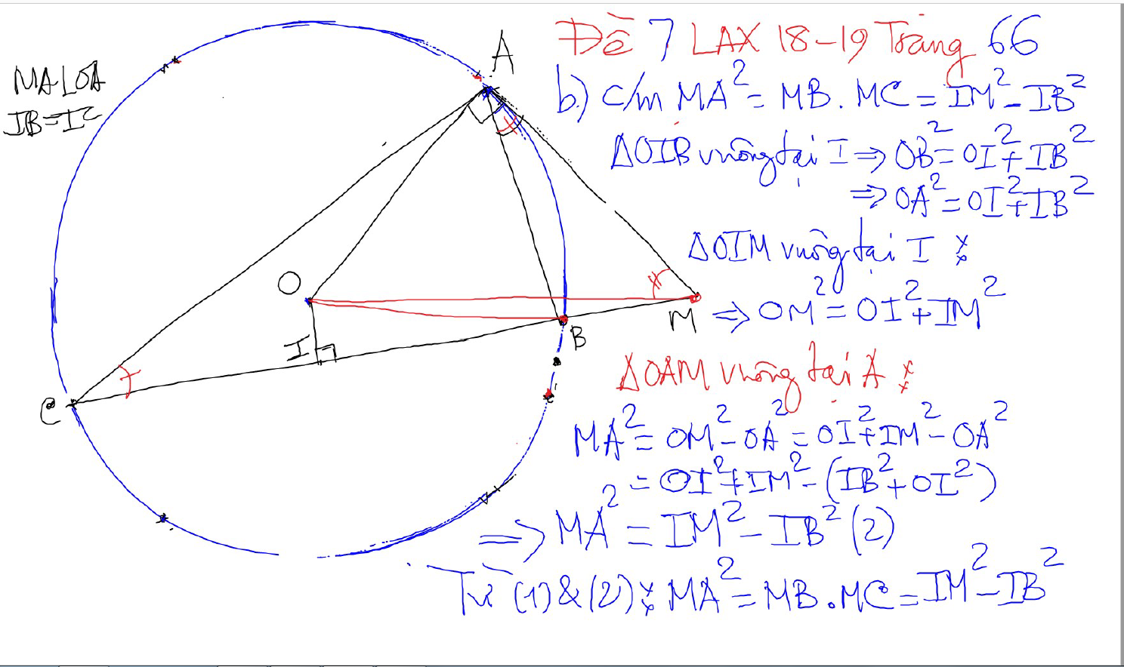
CONG THUC – SO HOC

Slide 2
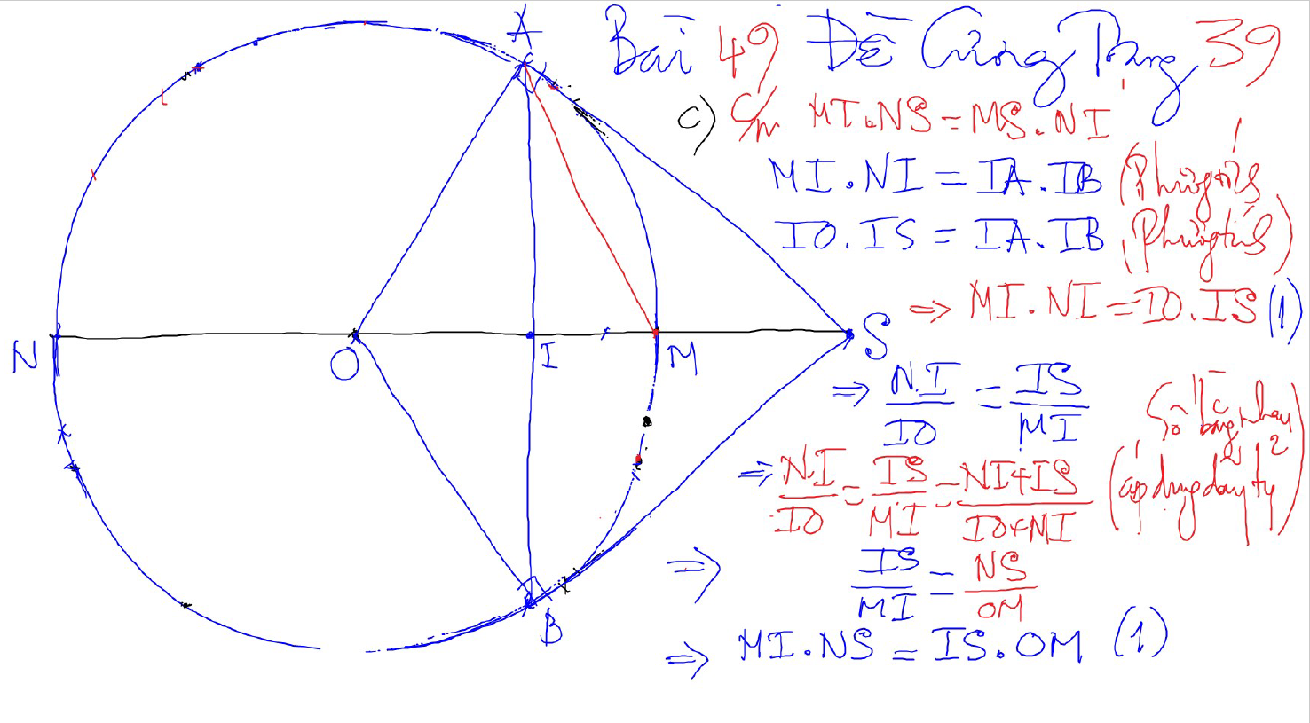
CONG THUC – SO HOC

Slide 3
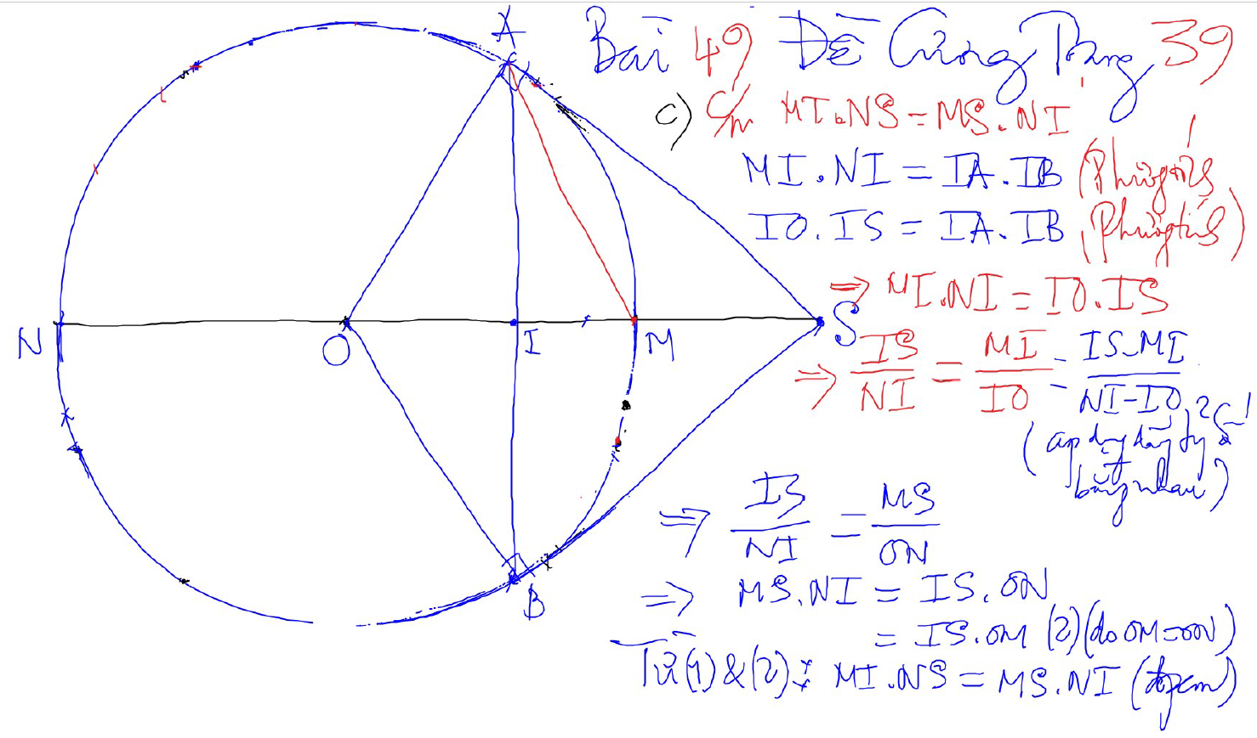
CONG THUC – SO HOC

Slide 4
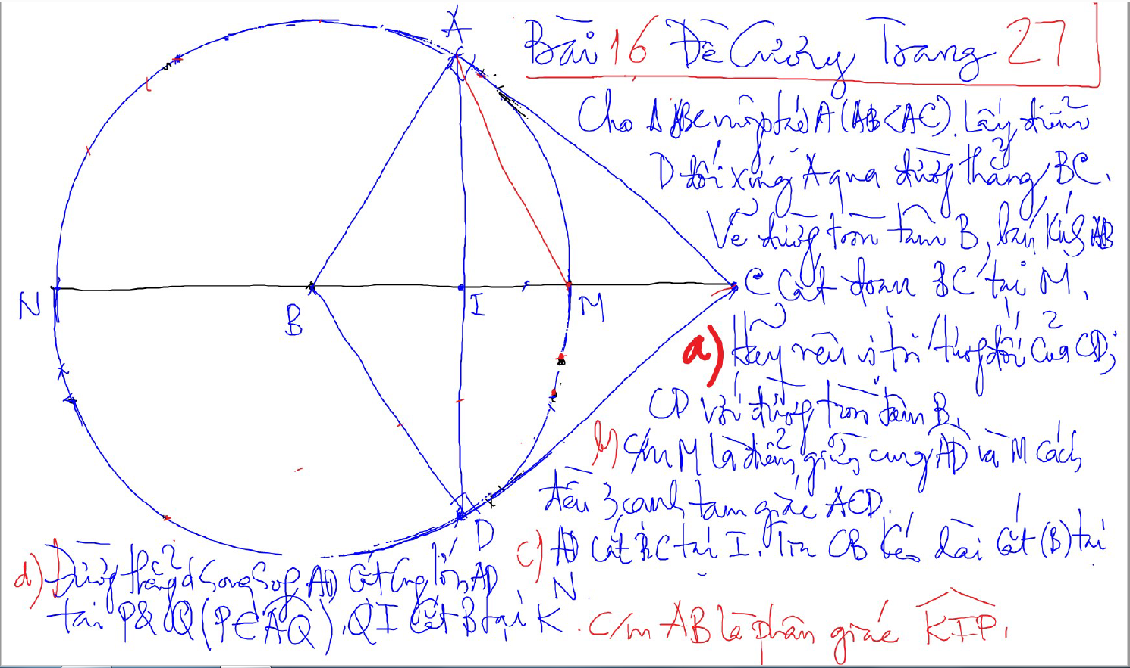
CONG THUC – SO HOC

Slide 5
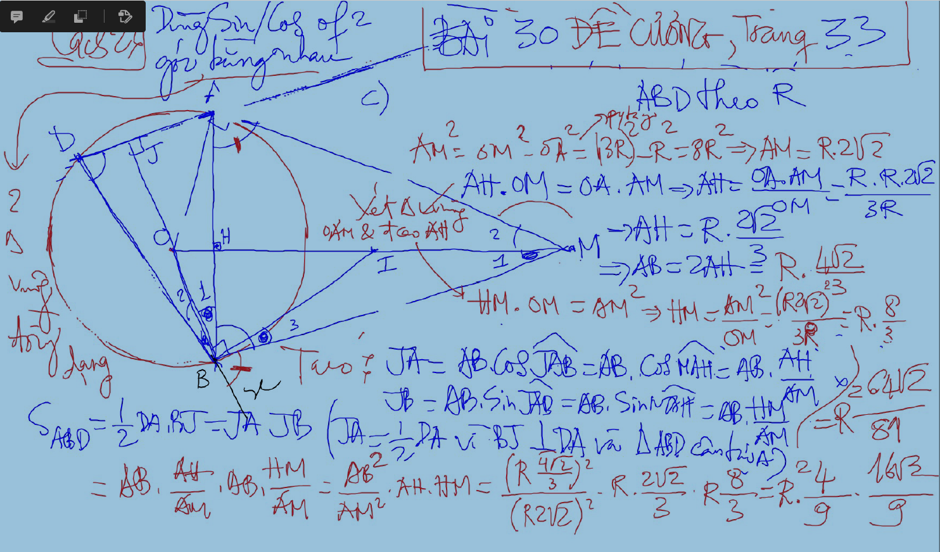
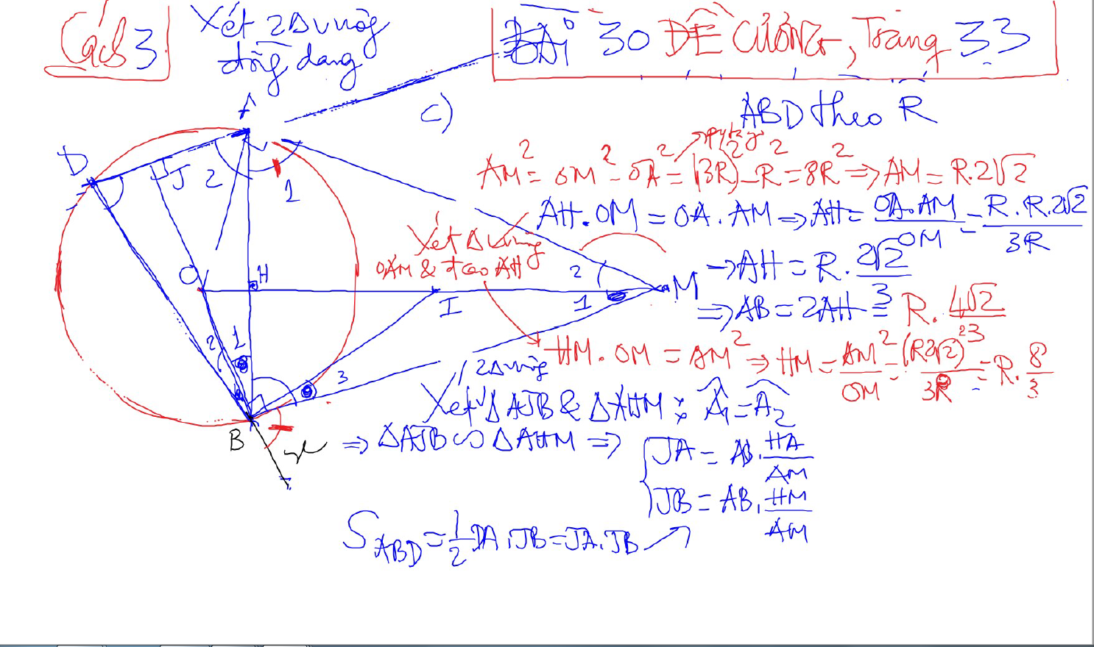
CONG THUC – SO HOC

Slide 6
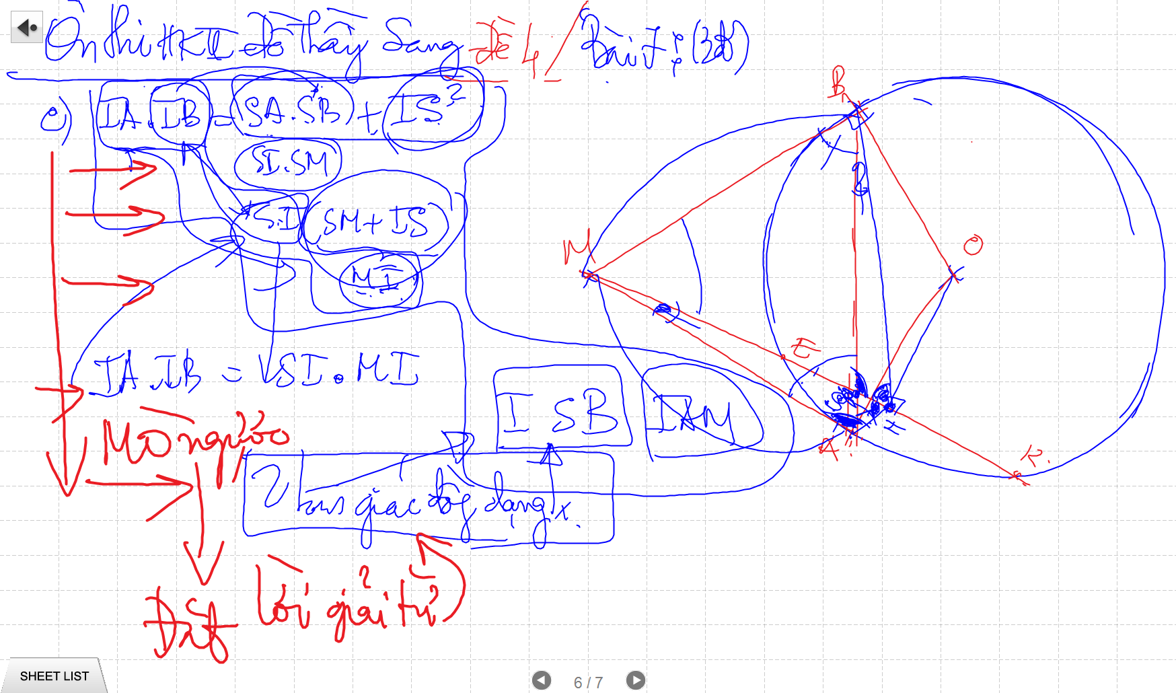
CONG THUC – SO HOC

Slide 7
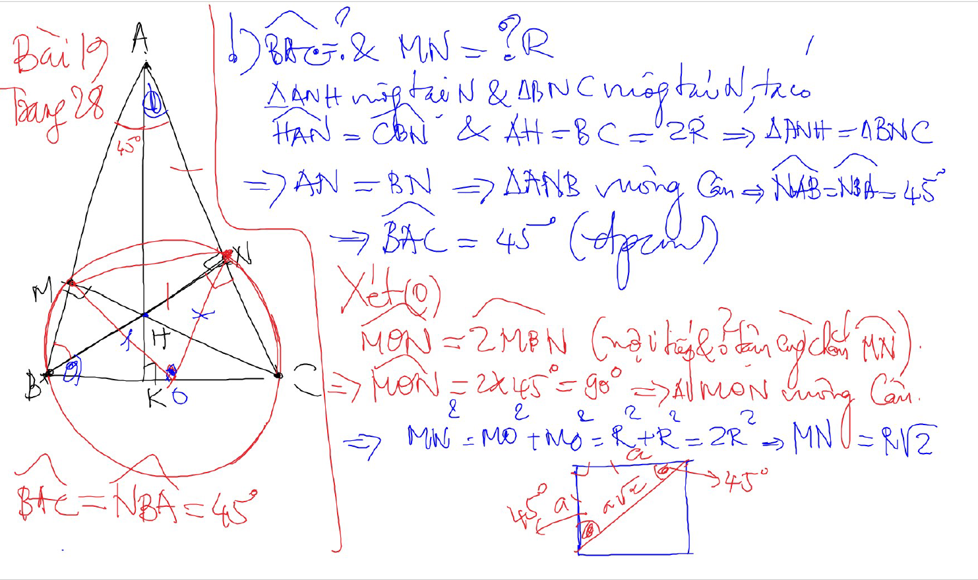
TINH SO DO GOC

Slide 8
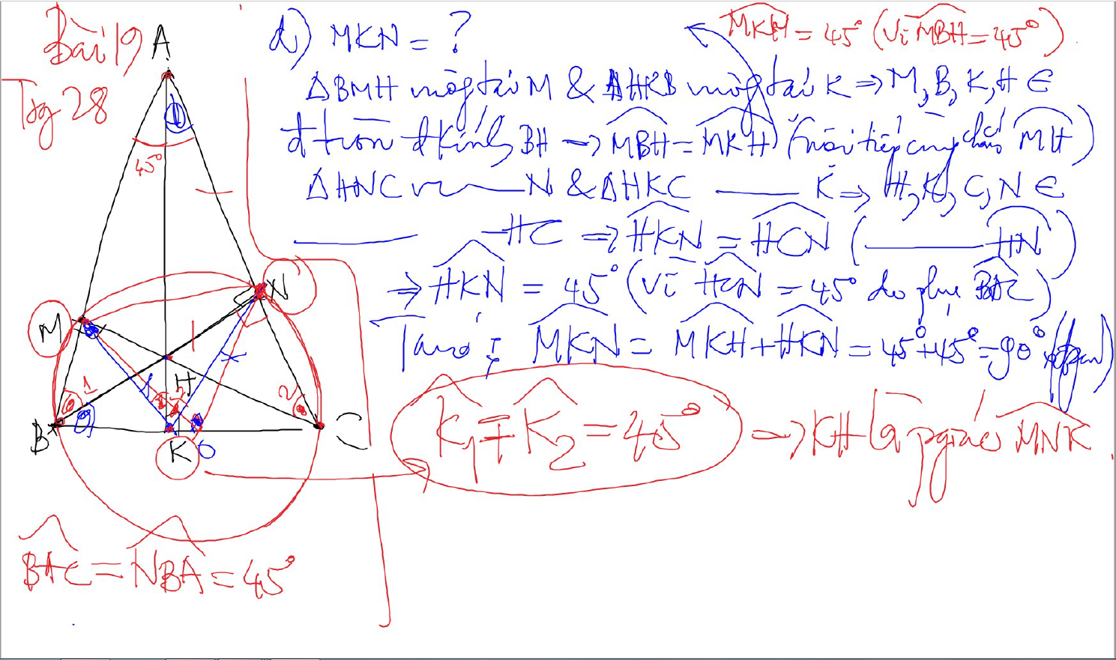
TINH SO DO GOC

Slide 9
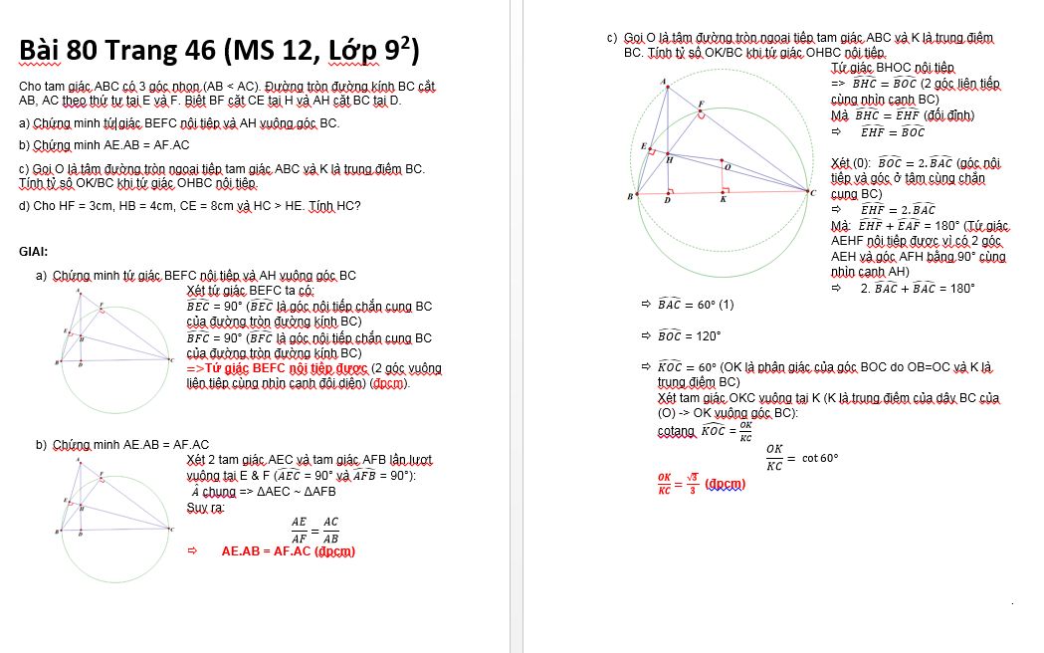
TINH SO DO GOC

Slide 10
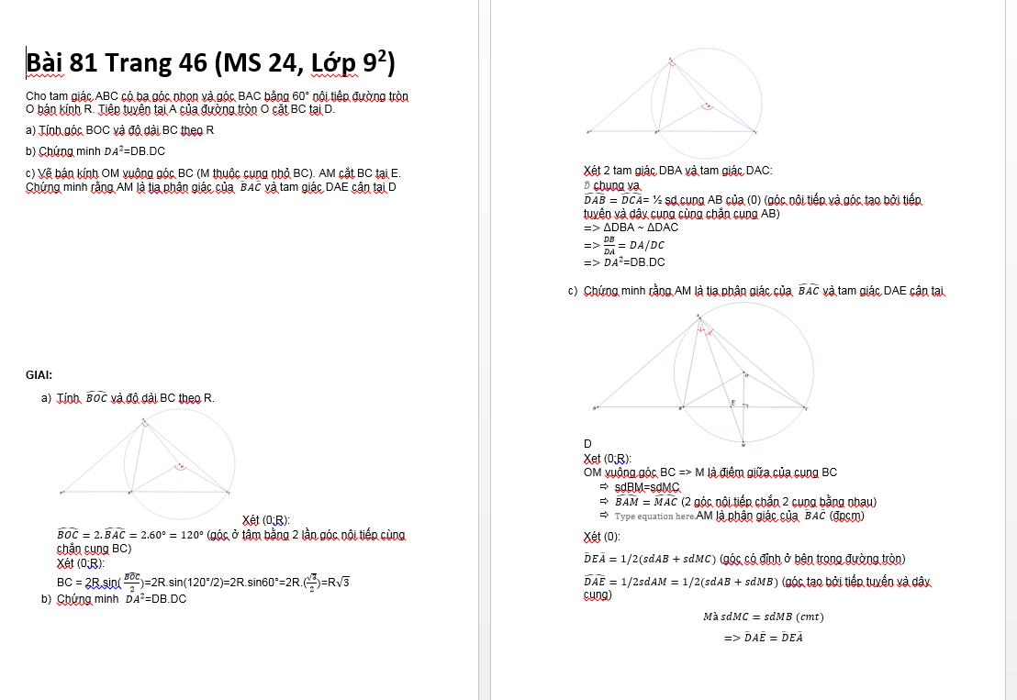
TINH SO DO GOC

Slide 11
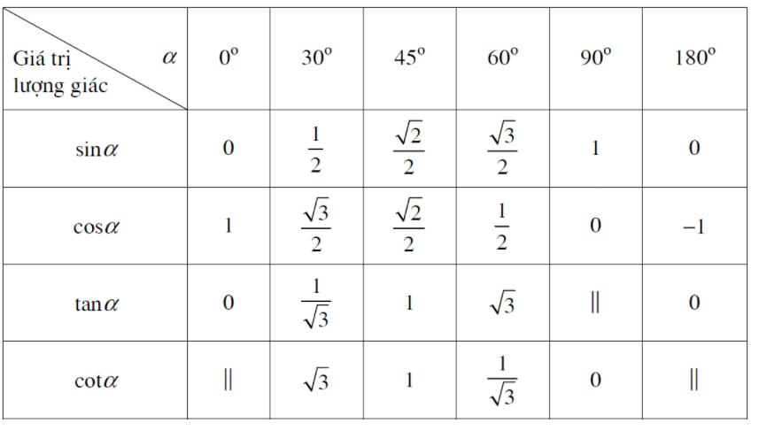
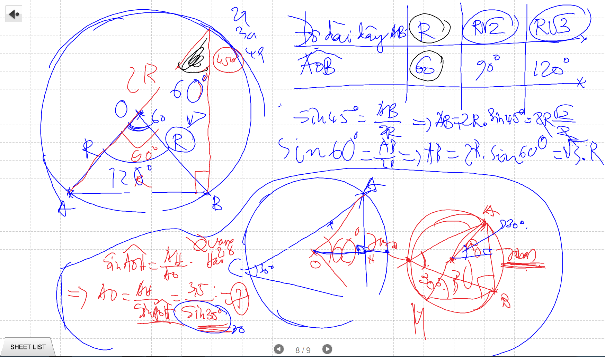
TINH SO DO GOC

Slide 12
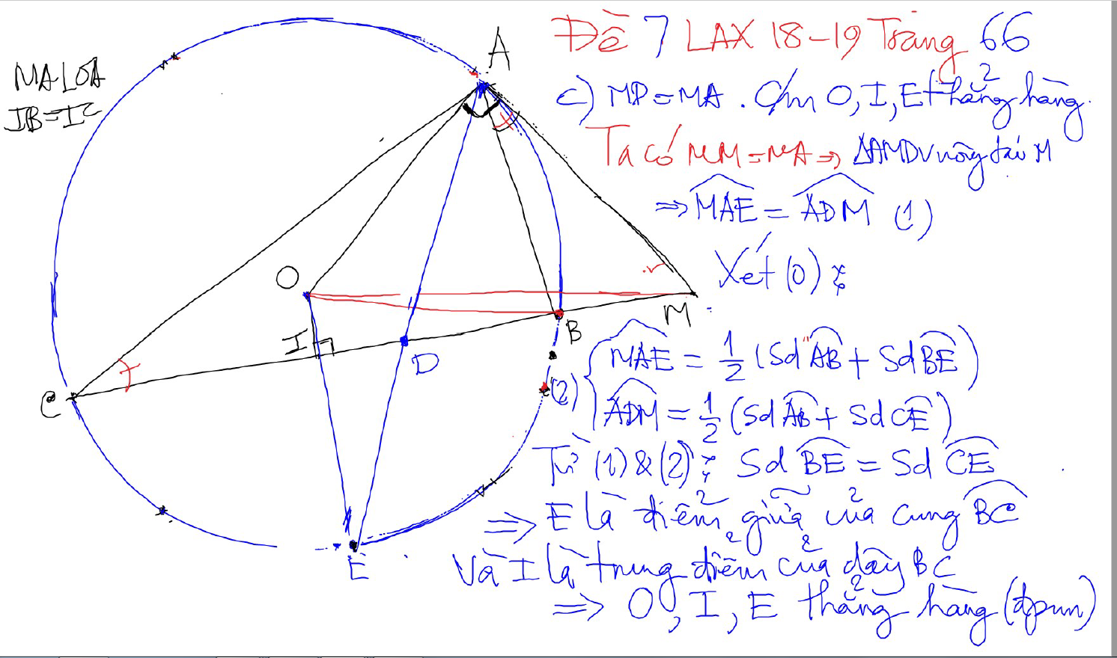
CHUNG MINH THANG HANG

Slide 13
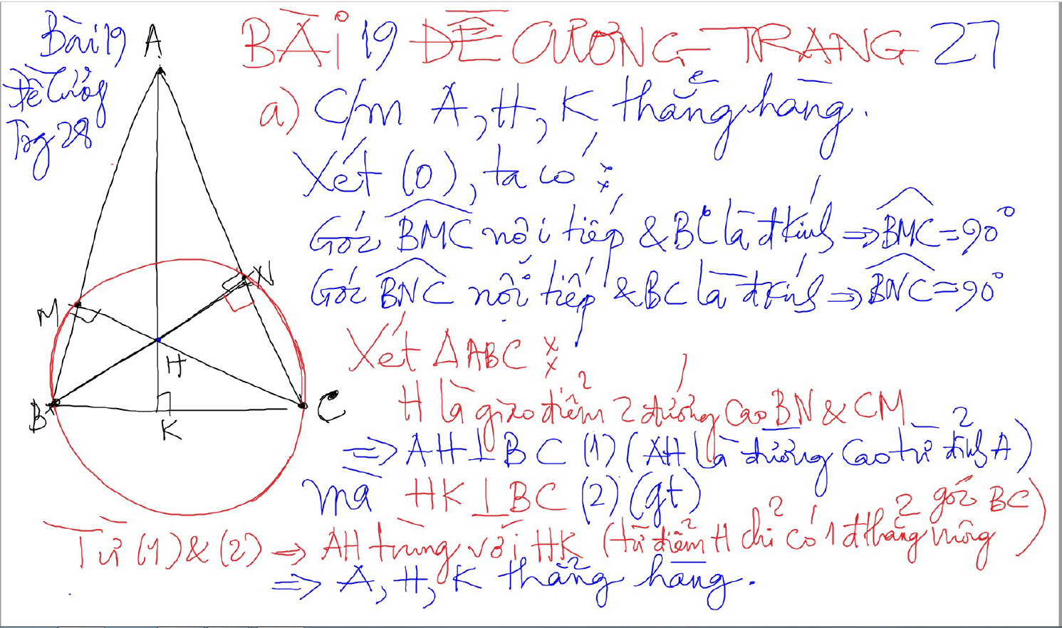
CHUNG MINH THANG HANG – 2 doan thang co 1 diem chung va cung vuong goc voi 1 dthang

Slide 14
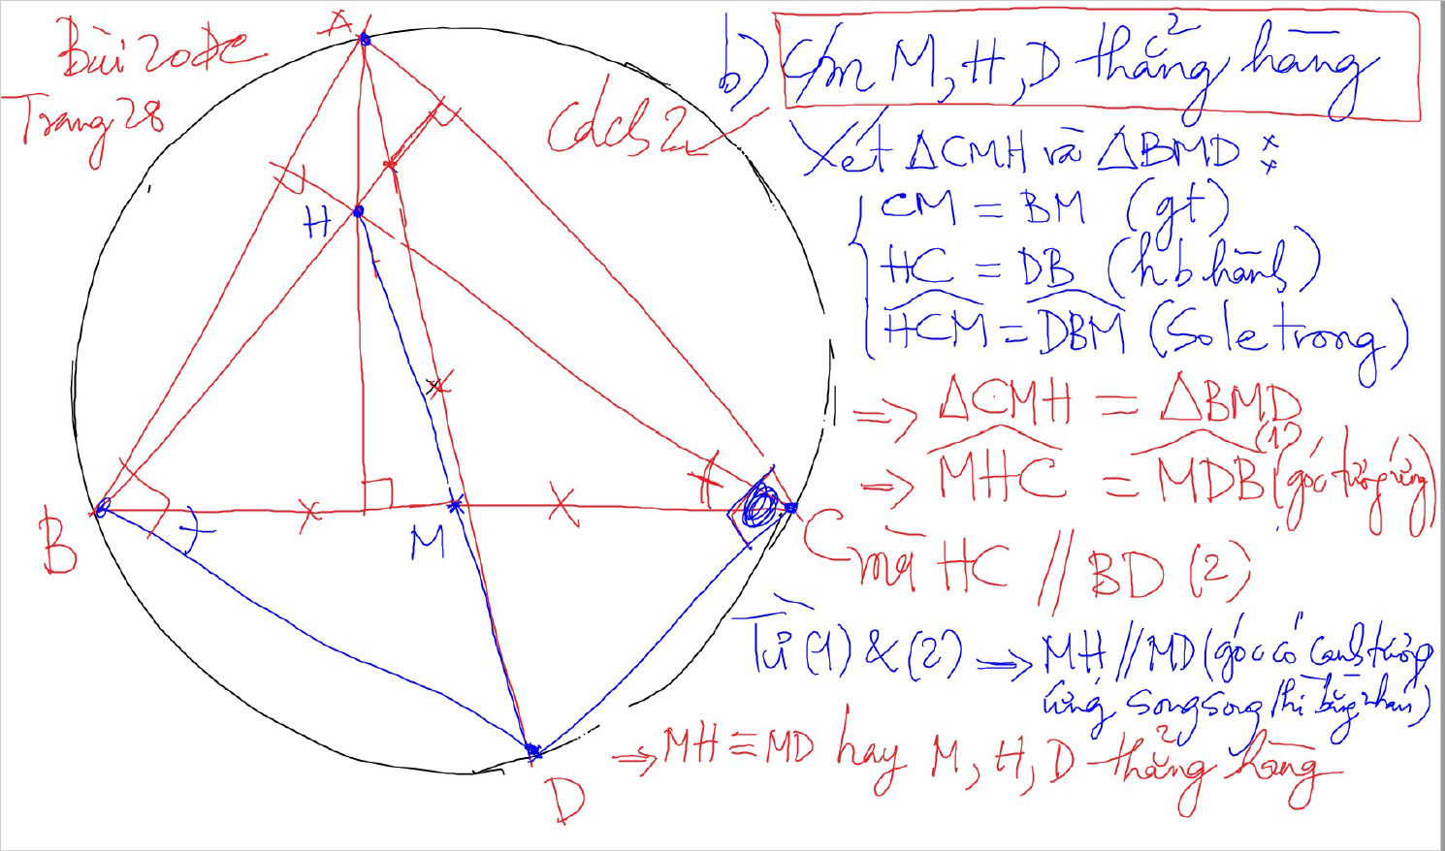
CHUNG MINH THANG HANG – 2 doan thang co mot diem chung va song song -> thang hang

Slide 15
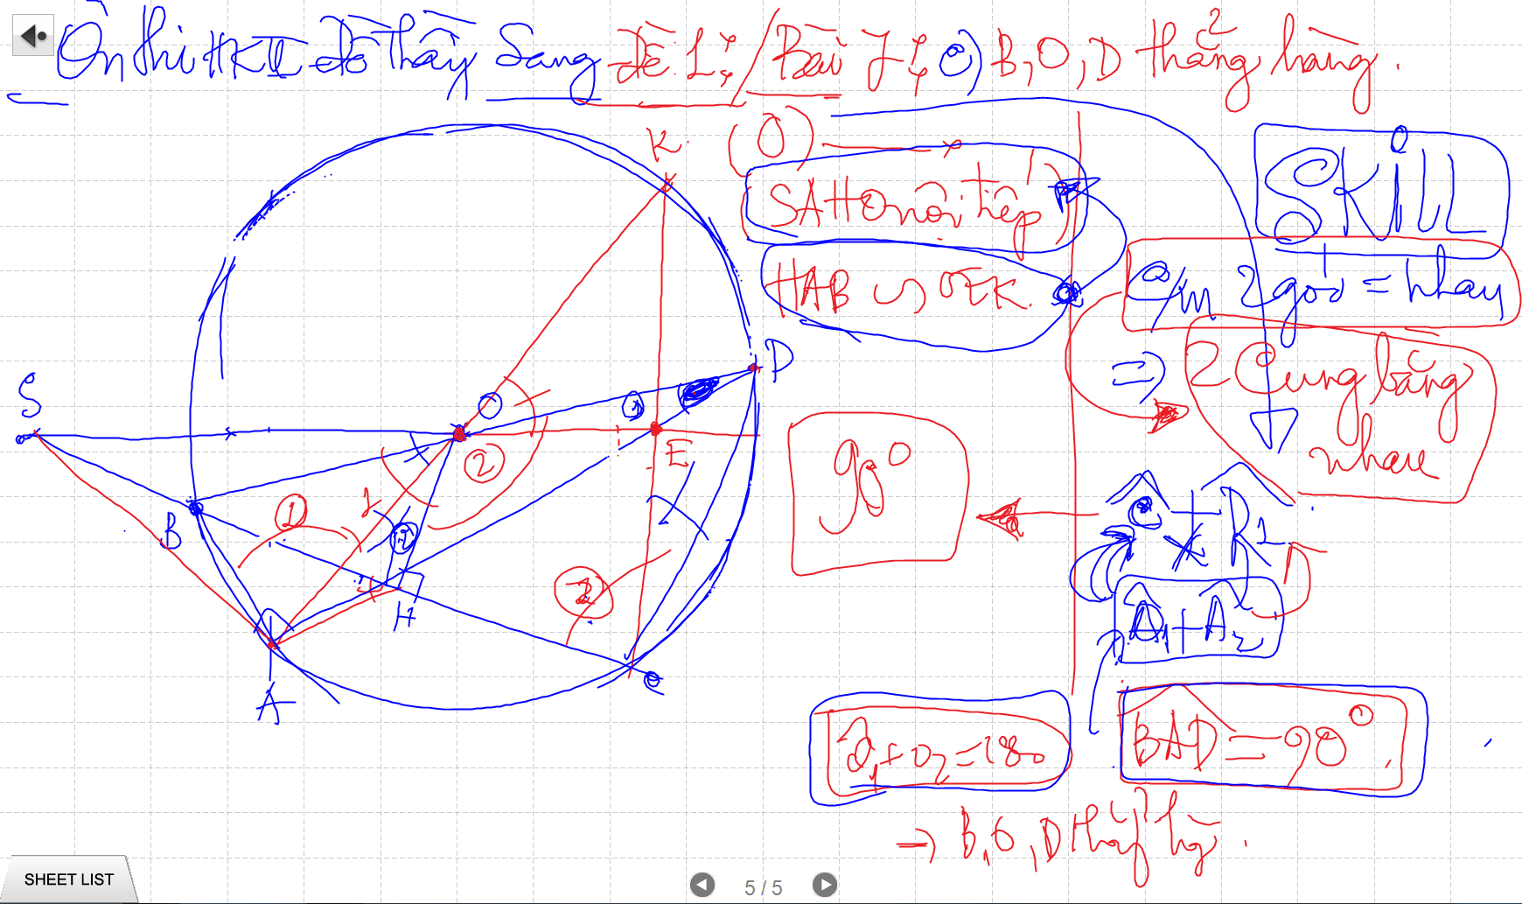

Slide 16
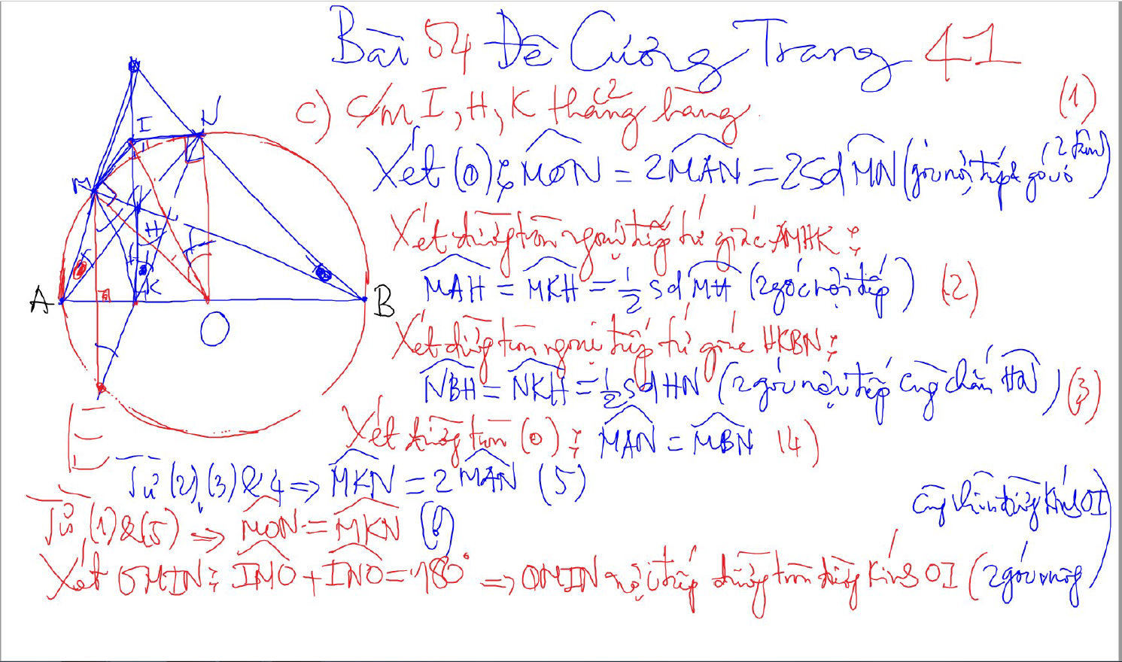
CHUNG MINH THANG HANG – 2 doan thang co 1 diem chung va cung vuong goc voi 1 dthang

Slide 17
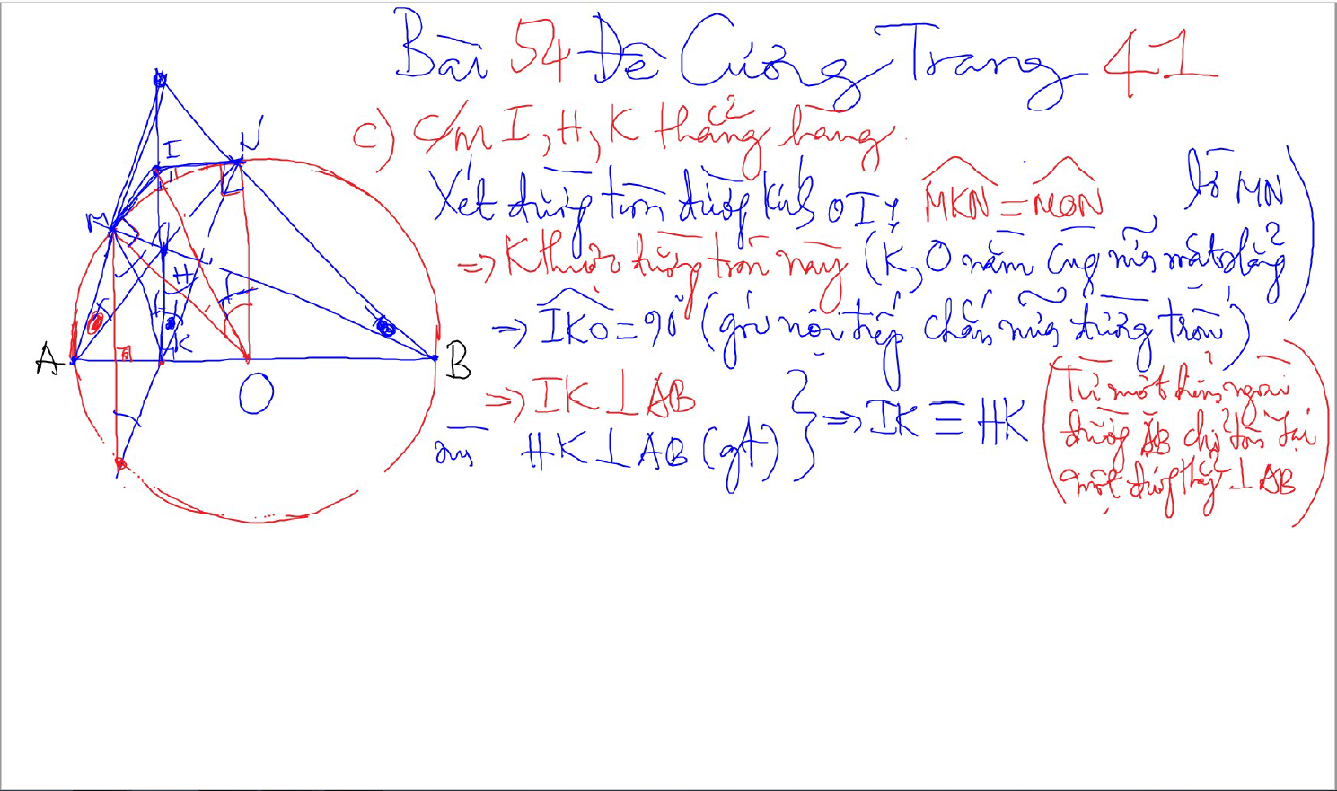
CHUNG MINH THANG HANG – 2 doan thang co 1 diem chung va cung vuong goc voi 1 dthang

